Slide 1
ADAS SW Stack

Slide 2
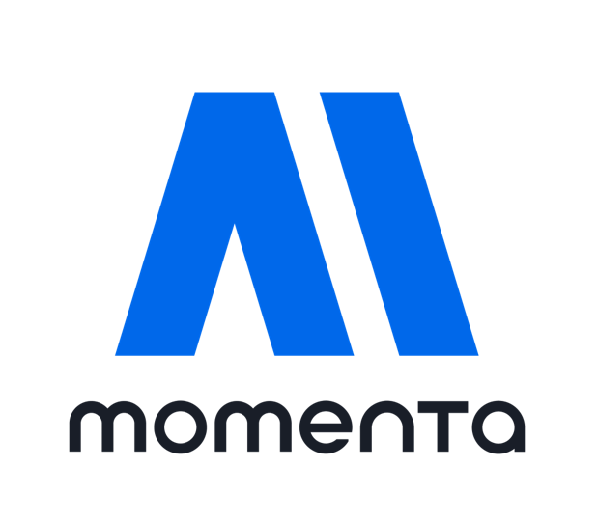
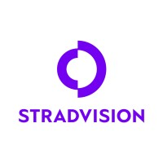


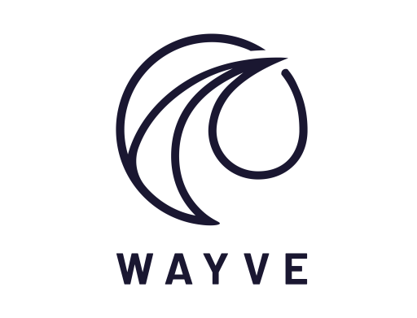


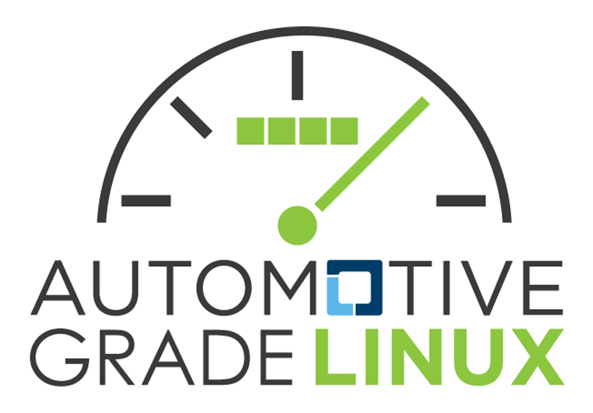


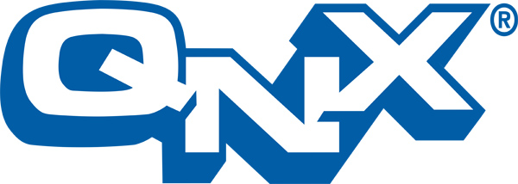
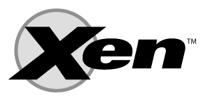
Application
High-level ADAS features
Autopilot, Valet Parking, Adaptive Cruise Control, Parking Assist
Middleware
Libraries, algorithms, abstraction layers
Sensor fusion, perception, planning algorithms
OS: Linux, AUTOSAR Adaptive, Android Automotive OS
RTOS: QNX, AUTOSAR Classic, Zephyr, FreeRTOS
OS
System OS/RTOS
Hypervisor
Run & manage multiple OS’s/RTOS’s
QNX, Xen
Hardware
Sensors and compute platforms
LiDAR, radar, cameras, compute platforms

Slide 3





L2/L2++ Mpilot & MSD ADAS
L4 robotaxi
Large scale data collection through OEM partnerships
CABIN EYE modular SW suite for driver & passenger monitoring
Designed to enhance L2+
Application
High-level ADAS features
L2+, L3 & L4 product ADAS solutions
Unified ADAS model
Vision-first approach
L2/L2+ consumer & L4 robotaxi
Vision-first perception
Unsupervised learning approach
SVNet: Perception software
Partnerships with OEM’s & platforms for optimization
Perception stacks, sensor fusion, large scale data collection
AI perception frameworks
Middleware
Libraries, algorithms, frameworks

Slide 4
SW Vendor Partnerships
Momenta
Mercedes using Momenta for urban naviagation assistance in L2+ ADAS (nvidia orin HW, electric CLA car, production 2025)
IM Motors & Nvidia & momenta (Drive AGX Thor HW) launch ADAS solution in 2025 for IM motors
HNP high-speed elevated navigation assistance, urban navigation assistance, memory parking assisntance
Toyota using Momenta ADAS solution, “jointly created an end-to-end, full-scenario intelligent driving solution” (Toyota BZ3X car)
Toyota partnered with Huawei, momenta. Toyota integrating a system using Huawei hardware and Momenta ADAS stack
BYD & Momenta established $15.7M venture (DiPi Intelligent Mobility Co) to deploy AD across some BYD models
Nvidia & Momenta partnered to create a ADAS SW/HW solution using Drive Orin SoC
GM China using Momenta for its Autonomous vehicles
Qualcomm & Momenta will develop AD platforms based on Snapdragon Ride targeting $14k—$28K cars
Audi & SAIC motor have a venture that Momenta will contribute to the AD system

Slide 5
Stradvision
Stradvision partnered with Horizion Robotics to have their SVNet product optimized on Horizon journey 3
Stradvision is working with ”a leading German Automotive OEM” and global T1
Stradvision using QNX SW
Renesas & Stradvision collaborate on object detection solution
Stradvision SW optimized for Renesas R-Car SoC
Emotion3D
BrainChip partnered with emotion3D to do demos
Helm.ai
Ambarella and Helm.ai partnered, Helm.ai SW available on Ambaerlla SoC’s
Wayve
Uber collaborating with Wayve to deploy AD vehicles

Slide 6
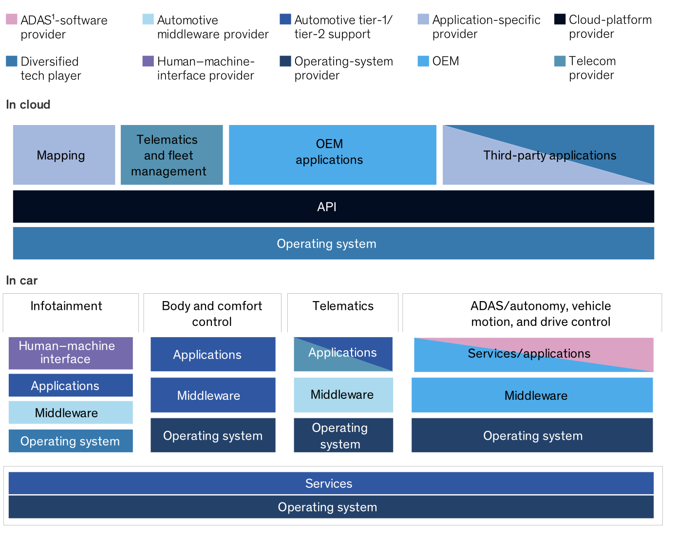

Slide 7
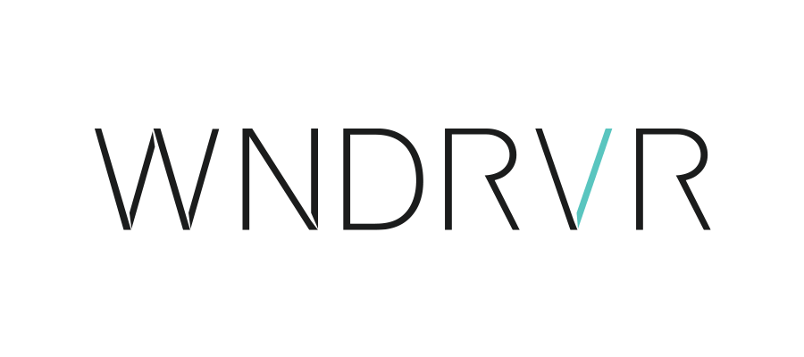


RTA-OS: AUTORSAR Classic (RTOS)
RTA-VRTE: AUTOSAR Adaptive (OS)
VxWorks RTOS
ASIL D compliance
Multi-core and hypervisor support
RHEL: General purpose Linux for connected vehicles (OS)
Real-time Linux Kernel (OS/RTOS)
IVOS: Modular platform for SDVs (OS)
OS
System OS/RTOS
RTOS for deterministic performance
ASIL D certified
Open-source RTOS for embedded systems
Pursuing ASIL-B
Increasingly considered for automotive
SafeRTOS is an open-source light-weight RTOS for embedded systems/simple tasks
ISO26262 certified
Supports multicore processors
Allows for QNX, Linux, Android
Open-source, full virtualization
Supports paravirtualization and hardware-assisted virtualization
Can run on Arm-based systems
Hypervisor
Run & manage multiple OS’s/RTOS’s

Slide 8
OS Vendor Partnerships
ETAS (Bosch)
ETAS collaborates w/QNX to integrates ETAS AUTOSAR adaptive w/ QNX RTOS & hypervisor
Red Hat collaborates w/ ETAS to create a scaleable, pre-integrated SW platform for ADAS (allows for faster testing and deployment of ADAS systems) (ETAS middleware on top of RedHat automotive OS)
Wind River
Hyundai partnered with Wind River to try and create better SW dev infra

Slide 9
IP Vendor Partnerships
ARM
Arm partnered with Panasonic Automotive Systems to standardize SDVs
LeddarTech (automotive SW) partnered with Arm to optimize LeddarVision on Arm AE compute
Also using TI processors
Tata Technologies signed Memorandum of Understanding w/ Arm to develop Automotive SW and system for SDVs’
Tata will enable its SW on the Arm AE profile and Compute Subsystems
Tier IV (and AWF) partnered with Arm to launch new virtual platforms and software solutions on Arm AE
Tier IV is integrating its DevOps and MLOps for AD with virtual Arm models running on AWS
Cadence partnered w/ Arm to deliver a chiplet-based reference design and SW dev platform to accelerate SDV innovation

Slide 10
Safety Linux Categories
Native Safety-Certified Linux Distributions
Linux-based OS that have been modified to meet FuSa standards
Ex: Wind River Linux, Red Hat In-vehicle OS
Use cases: Safety critical systems
Safety Linux Paired w/ Hypervisors
Combines general-purpose Linux systems with a hypervisor, isolating safety critical tasks
Ex: QNX SDP w/ Safety Linux Components
Use cases: Mixed-critical workloads
Hybrid Safety Linux Solutions
Combined open-source Linux w/ additional safety SW layers, toolchains or environments to meet FuSa requirements
Ex: Automotive grade linx
Use cases: Non-critical (Infotainment)

Slide 11
AUTOSAR: Automotive Open System Architecture
Open and standardized software architecture
Provides a framework for developing ECU software
Many T1’s, OEM’s collaborate to establish the standard (Bosch, BMW, Renesas, NVIDIA, etc.)
Ensures modularity, scalability, interoperability compatibility
FuSa support (ISO26262 compliance)
Classic AUTOSAR
Real-time, safety-critical systems (braking, engine control, steering)
Adaptive AUTOSAR
High-performance applications (ADAS, infotainment)
POSIX-based OS’s

Slide 12
Look into vendors partnerships w/ OEM’s, T1’s, semiconductor companies, etc
IP
More development SW tools, sdk, up to OS level
SoC
Requires full functionality SW stack
Think about how the SW would demo on TT server hardware
IP vs SoC partnerships would be different
Explore more about each companies product
Understand how the products work
Add:
Look at Automotive SW ecosystem explanations/papers/videos

